Slide 1
Deep Learning
Chapter 11 – Practical Methodology

Slide 2

11 Practical Methodology
A good machine learning practitioner needs to know how to choose an algorithm for a particular application and how to monitor and respond to feedback obtained from experiments.
During day-to-day development, practitioners need to decide whether to:
Gather more data
Increase or decrease model capacity
Improve approximate inference in a model
Debug the software implementation

Slide 3
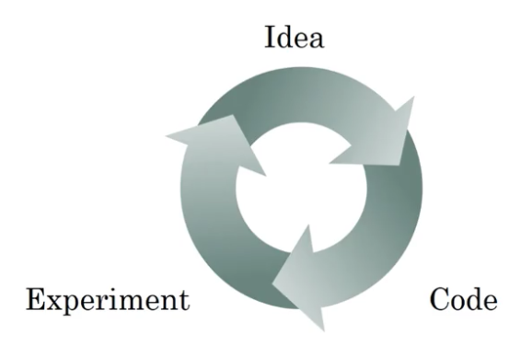
11 Practical Methodology
Many of the recommendations in this chapter are adapted from Andrew Ng (2015)
The book recommend the following design process
Determine your goal – What error metric to use
Establish a working end-to-end pipeline as soon as possible
Determine bottlenecks in performance (diagnostic)
Make incremental changes (from list on previous slide)

Slide 4
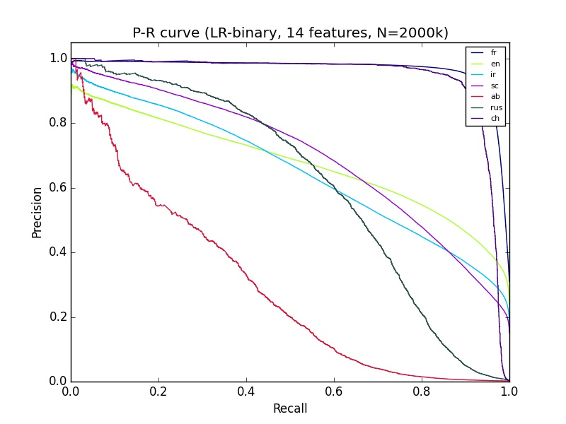
11.1 Performance Metrics
Common to measure the accuracy of the model (or error rate)
This metric will guide all future actions
Many applications require more advanced metrics
Precision and Recall
Total area under the PR-curve
F1-score
Notes:
Story about NOBIM/Jarle/SNR vs MSE.

Slide 5
11.2 Default Baseline Models
Next step is to establish a end-to-end system
Maybe even start without using deep learning
Choose the general category of model based on the structure of your data:
Fixed-size vectors Feed forward network (fully-connected layers)
Image Convolutional networks
Sequence Gated recurrent nets (LSTM or GRU)

Slide 6

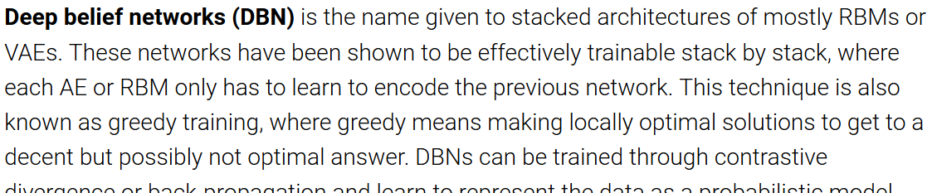
Image courtesy: http://www.asimovinstitute.org/neural-network-zoo/

Slide 8

11.3 Gather More Data?
If the performance on the training set is poor, the learning algorithm is not using the training data that is already available, so there is no reason to gather more data.
If performance on test set is much worse than training set, then gathering more data is one of the most effective solutions.
If performance on test set is acceptable, then there is nothing left to be done.
Gathering more data is not always possible
Dataset augmentation

Slide 9
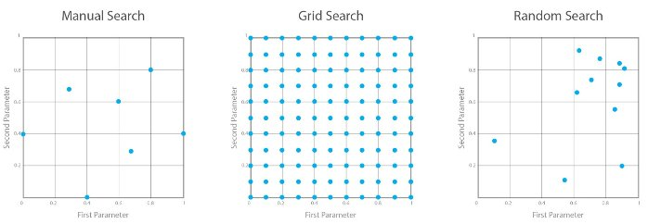
11.4 Selecting Hyperparameters
Stage your search from coarse (wide hyperparameter ranges, training only for 1-5 epochs), to fine (narrower rangers, training for many more epochs)
Manual / grid / random search

Slide 10
11.4 Grid Search
For each hyperparameter, select a small finite set of values to explore
The grid search algorithm trains a model for every joint parameter value
Chose values from a logarithmic scale
Learning rate {0.1, 0.01, 0.001, 0.0001}
Hidden units {50, 100, 200, 500, 1000, 2000}
Computational cost grows exponentially with number of hyperparameters.
If there are m hyperparameters, each with n values, the number of training and evaluation trials required grows as O(n^{m}).

Slide 11
11.4 Grid Search
Start with a broad search, train for few epochs
Hyperparameter {-1, 0, 1}
New narrow search, train for many epochs
Hyperparameter {-0.1, 0, 0.1}
Best value

Slide 12
11.4 Random Search
Converges much faster to good values (no wasted experimental runs)
Choose random uniformly distributed values
Learning rate = 10^{np.random.uniform(-1, -5)}
Dropout rate = np.random.randint(0, 1)
Start with a broad search, then refine search based on results from first search

Slide 13
11.5 Debugging Strategies
Machine learning systems are difficult to debug
We do not know what the intended behavior of the algorithm is
In fact, the entire point of using machine learning is that it will discover useful behavior that we were not able to specify ourselves
Useful debugging tests:
Visualize the model
Visualize mistakes
Design a case so simple that the correct behavior can be predicted

Slide 14
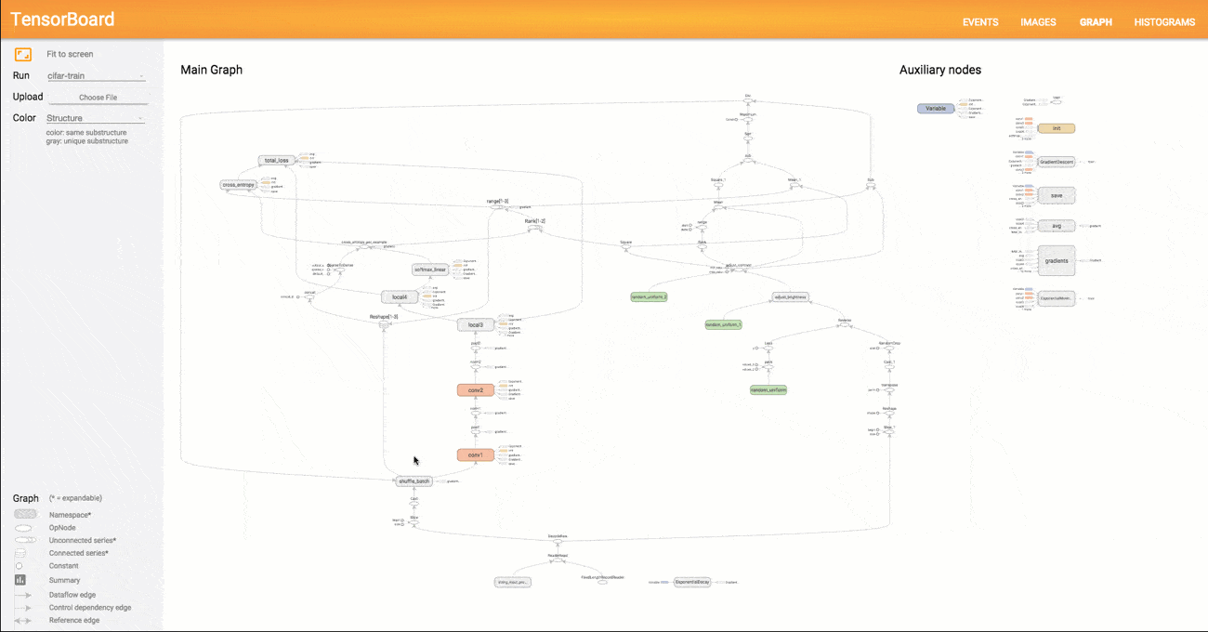
11.5 Debugging Strategies - Visualize the model
Tensorboard

Slide 15
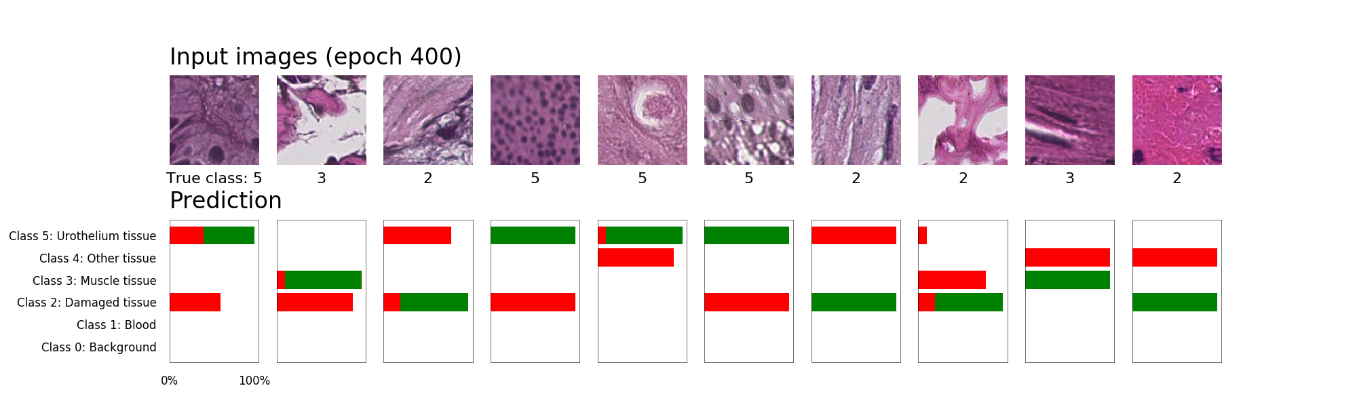
11.5 Debugging Strategies
Visualize misclassifications
Correct
Model prediction

Slide 16

11.5 Debugging Strategies – Bias/Variance
Set up development / test set and metrics
Set up a target
Build an initial system quickly
Train training set quickly: Fit the parameters
Development set: Tune the parameters
Test set: Assess the performance
Use Bias/Variance analysis and Error analysis to prioritize the next steps
Building a neural network is an iterative process
From Andrew Ng
Deep Learning Specialization
Coursera.org

Slide 17
11.5 Debugging Strategies – Bias/Variance
High bias on training data (Indicates Underfitting)
Try a bigger network
Train longer
Try another NN architecture
High variance on validation data (Indicates Overfitting)
More training data
Regularization
Try another NN architecture
Low bias
High variance
From Andrew Ng
Deep Learning Specialization
Coursera.org
Results from model trained on histological images of bladder cancer

Slide 18

Experiments!

Slide 19

Experiment Setup
Grid Search / Random Search
MNIST Dataset (60.000 train / 10.000 test)
Broad search for 5 epochs, then narrow search for 50 epochs
9 Different model architectures
Hyperparameters:
Learning rate (5 values)
Number of filters / feature maps (5 values)
225 models to train

Slide 20
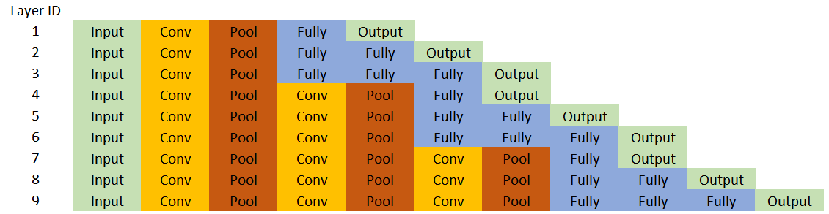
Model Architectures
Hidden layers uses ReLU activation function
Output layer uses Softmax activation function

Slide 21
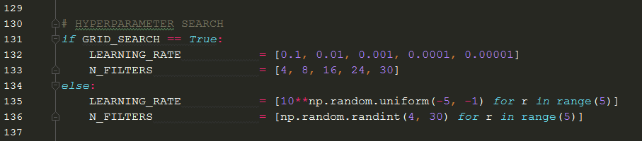
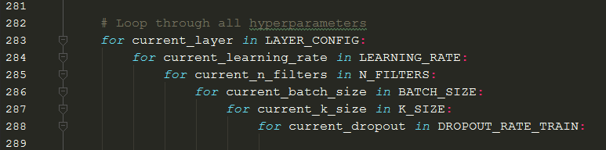
Implementation Parameter Search

Slide 22
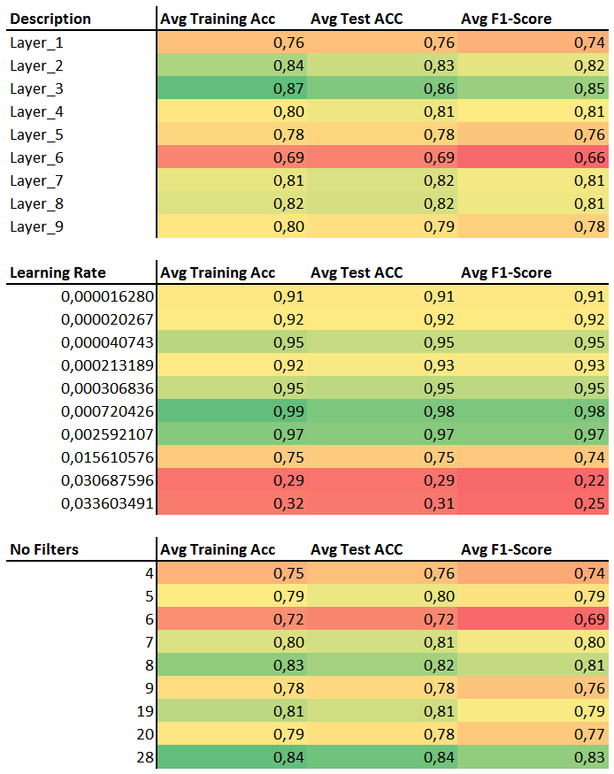
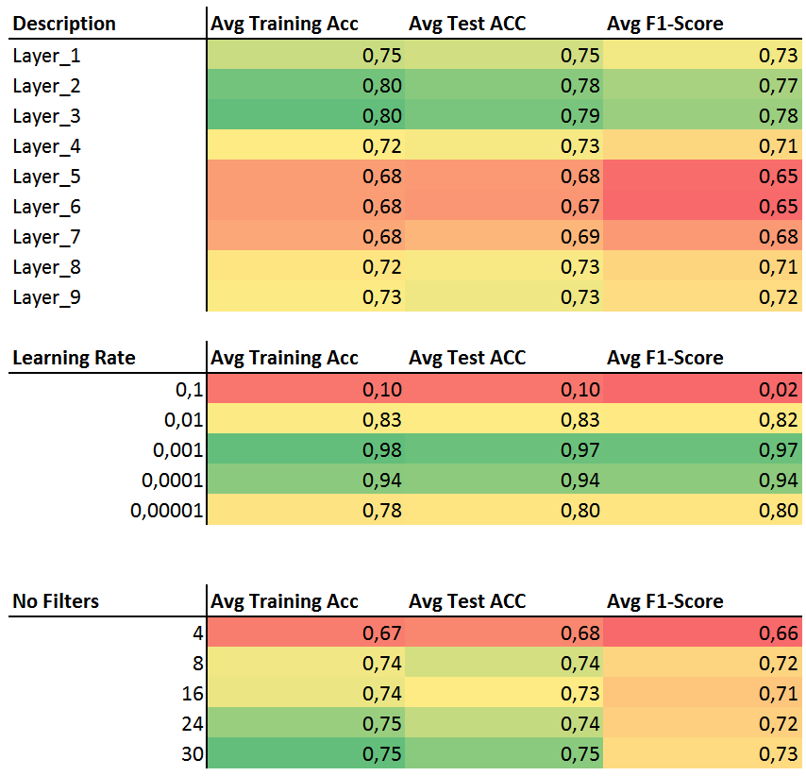
Result for Broad search, 5 epochs
Grid Search
Random Search
Narrow search
Narrow search
Narrow search
Narrow search

Slide 23
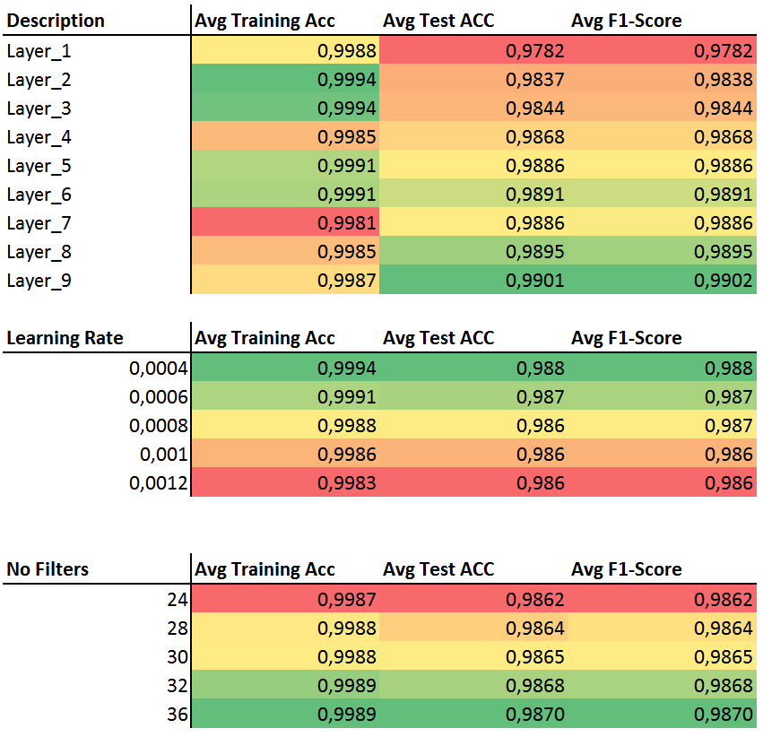
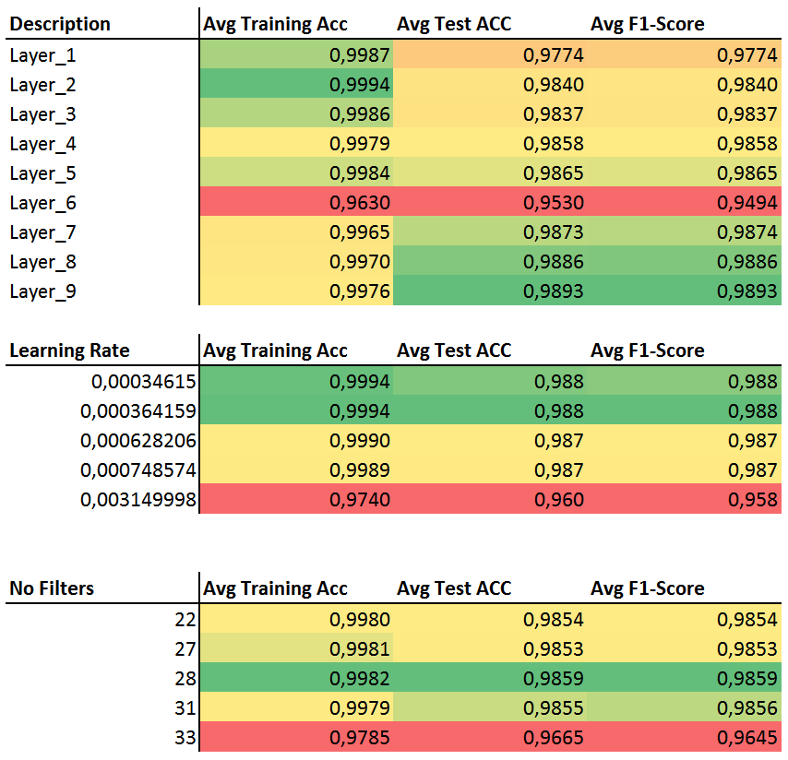
Result for Narrow search, 50 epochs
Grid Search
Random Search

Slide 24
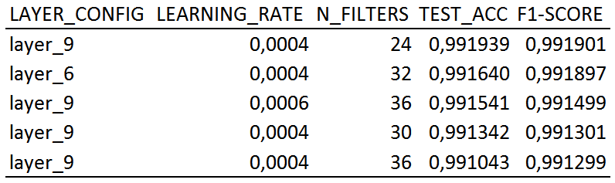
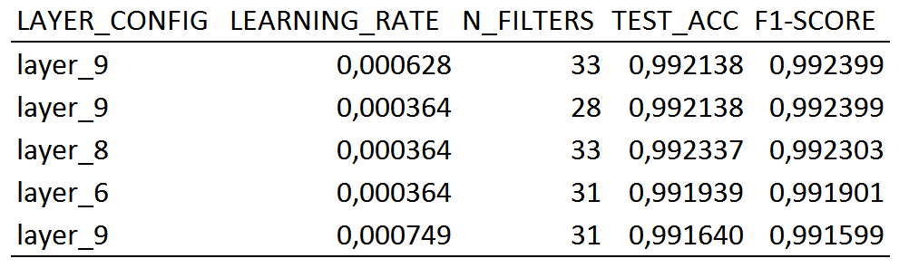
Comparison of the 5 Best Models
Grid Search
Random Search

Slide 25
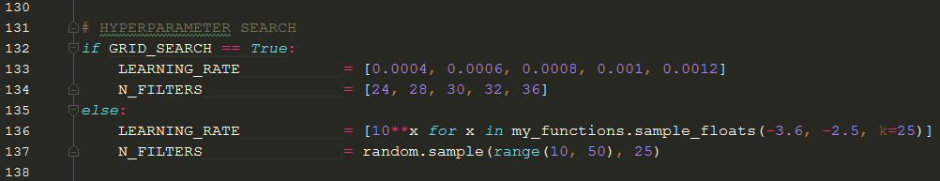
Implementation Update of Random Search
Old code
New code

Slide 26
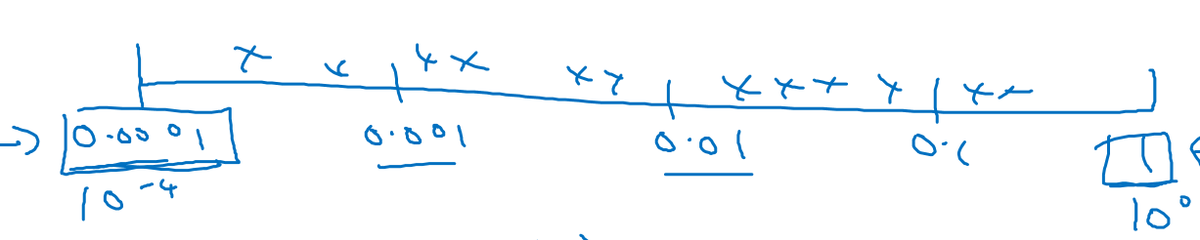
Final note on Random Search
Consider the scale to use on each parameter
Make sure no duplicated numbers are created
Generate random parameters for each model
Use bins to avoid large spaces in the parameters
From Andrew Ng
Deep Learning Specialization
Coursera.org

